Slide 1
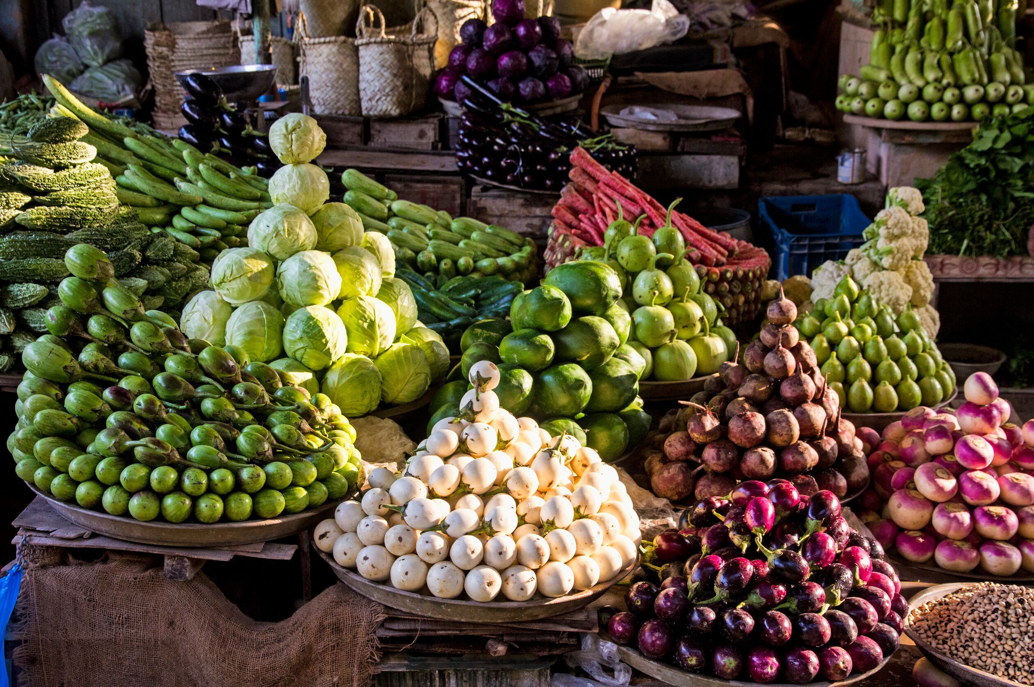
Market Basket Analysis
Group J
Francisco Hermenegildo | Gil Gonçalves | Ikram Bouziri

Slide 2
Agenda
1
Overview
2
Metrics
3
Array of product offering
4
Customer Behavior
5
Complementary items
6
Substitute items

Slide 3
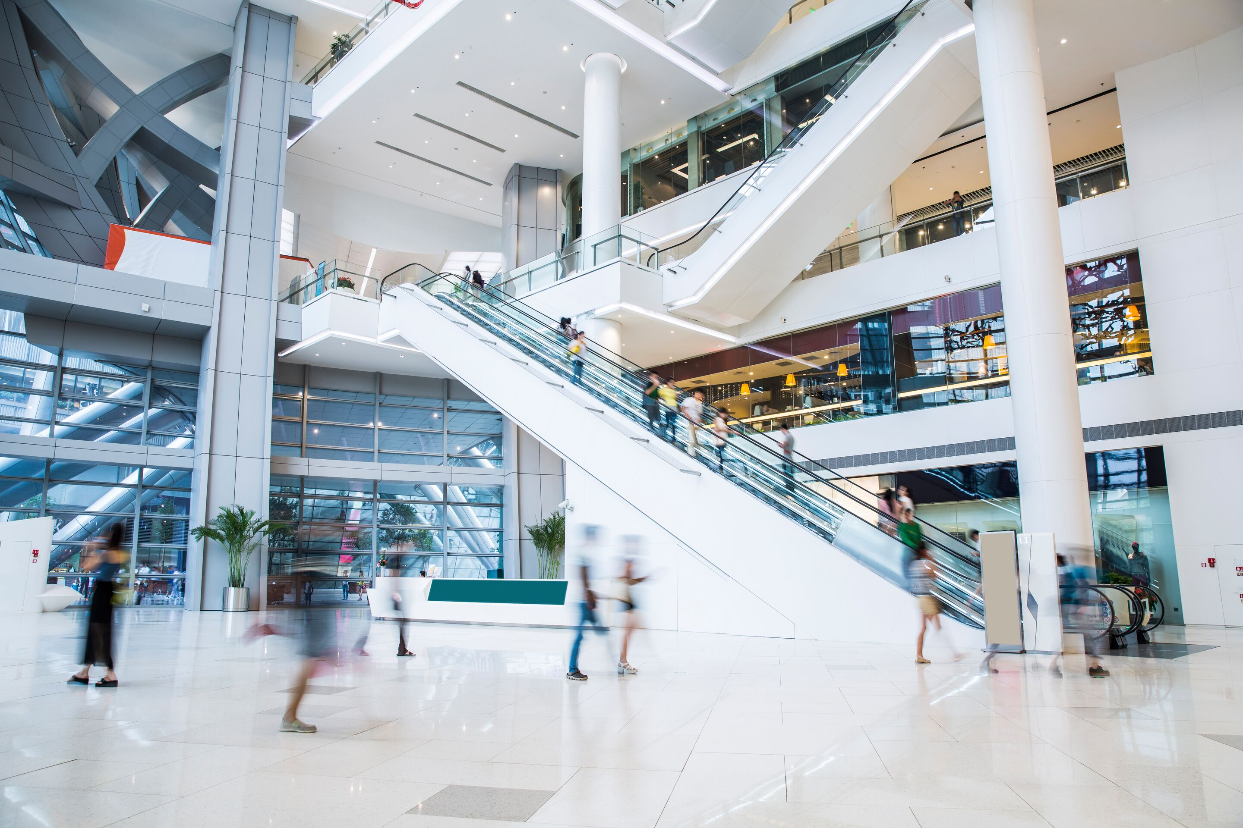
Overview
105.273
1,9
10,09
7,26
Number of customers to date
Average number of orders per customer
Average number of items per order
Average number of unique items per order

Slide 4
Association Rules - Metrics
Support
Confidence
Number transactions with item
Total number of transactions
Support (X&Y)
Support(X)
Low Support = the itemset does not appear frequently in the dataset
The percentage of a consequent appearing given that the antecedent has occurred
High Support = the itemset appears frequently in the dataset

Slide 5
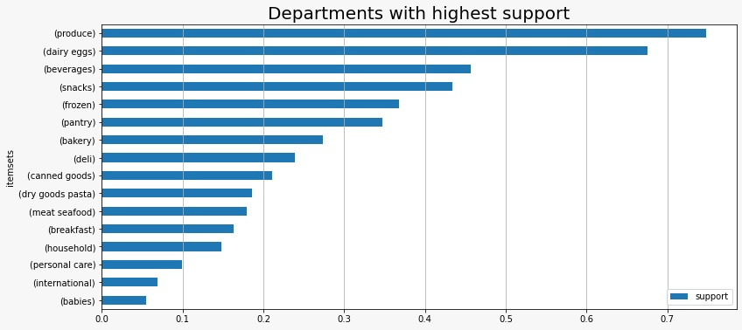
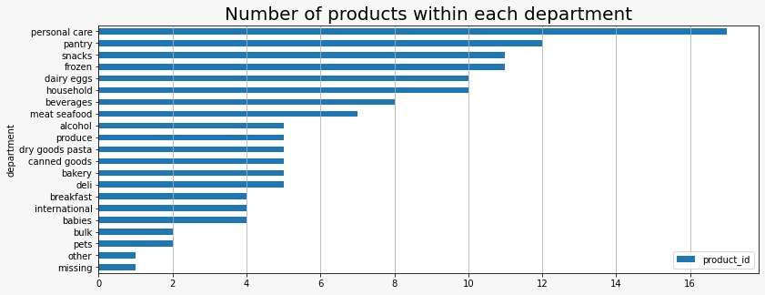
Department support vs array of products
Produce
Beverages
Bakery
High support
Low number of products

Slide 6
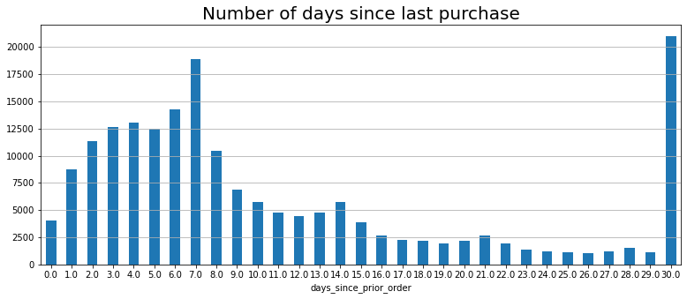
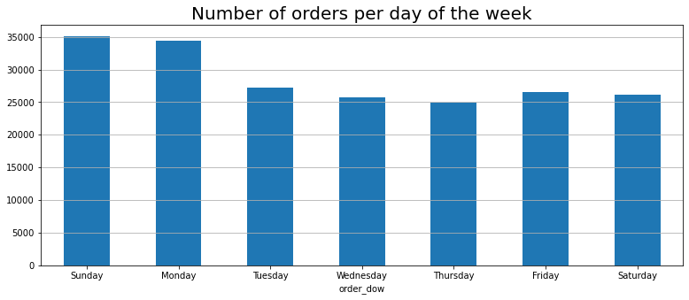
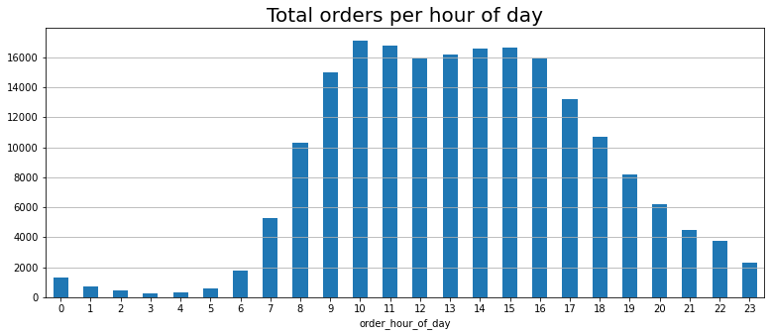
Customer behavior
35% reorder within 1 week; 10% buys < 1 month
48% of orders between Sunday and Tuesday
70% between 9 – 5pm

Slide 7
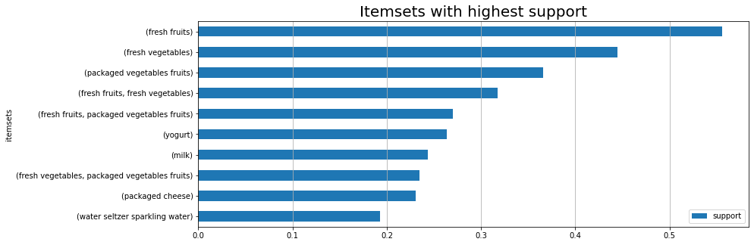
Customer behavior
Fruits and vegetable(packed and fresh) are the most purchased products

Slide 8
Association Rules - Metrics
Leverage
Lift
Support (X&Y) – Support(X)Support(Y)
Support (X&Y) / Support(X)Support(Y)
Ranges from -1 to 1
Ranges from 0 to infinite
Lift >1 = Items occur in transactions more often than expected based on individual support levels = Association
Positive Leverage = More purchases of products together than independently = Complementarity
Lift <1 = Items are paired together less frequently than expected if the pairings occurred by random chance = Dissociation
Negative Leverage = More products bought independently than together = Substitutivity

Slide 9
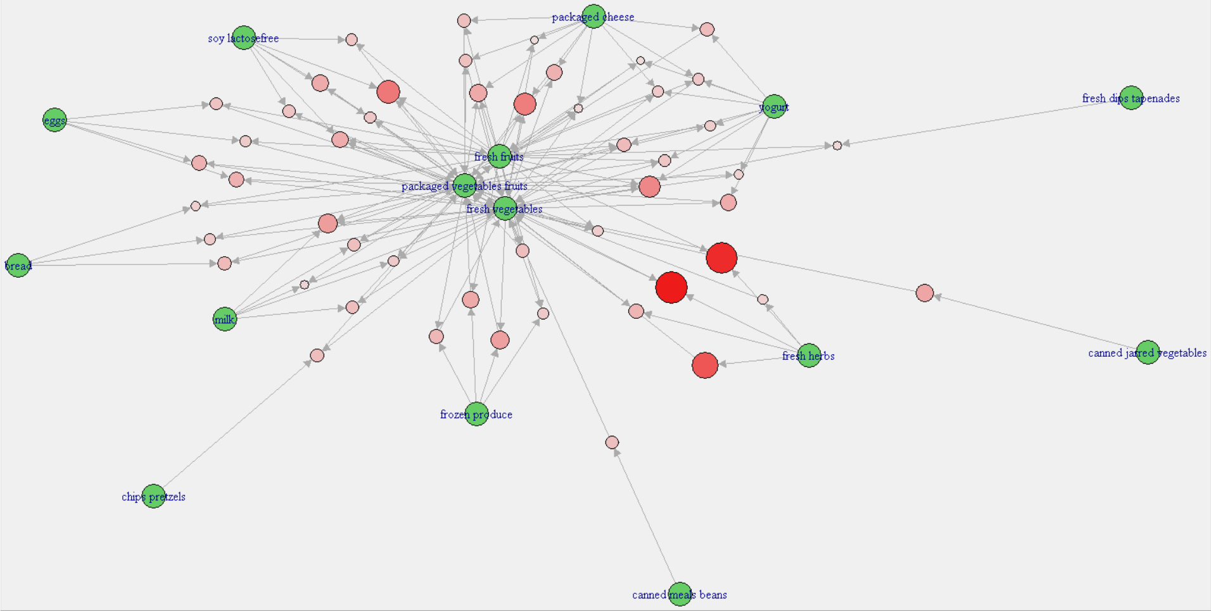
Complementary Items

Slide 10
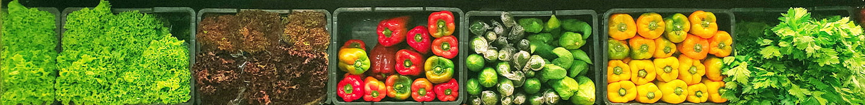
Complementary Items
Support > 0,05
Confidence > 0,5
Lift > 1
Fresh Herbs
Yogurt
Packaged cheese
Milk
Soy Lactose free
Eggs
Frozen Produce
Fresh fruits
Fresh Vegetables
Canned Jarred Vegetables
Fresh Vegetables
Packaged vegetables fruits

Slide 11
Substitute Items
Support > 0,02
Lift < 0,95
Fresh fruits
Fresh vegetables
Packaged Produce
Soft drinks
Yogurt
Milk

Slide 12
Thank You For Your Attention
Group J
Francisco Hermenegildo | Gil Gonçalves | Ikram Bouziri

